Slide 1


Dulles High School Y.E.S. Program
Xuan Mai, Tran

Slide 2
Agenda
General Purpose
Website Structure
Design
Main Pages
Javascript
Responsive

Slide 3


General Purpose
This website is a local branch of Y.E.S. Program at Dulles High School (DHS).
Its main purpose is to introduce, manage and recruit high school volunteers for DHS Volunteer Campaigns.
Y.E.S. Campaigns always focus on 2 main mission:
Community Support
Environment Support

Slide 4
Website Structure
Dulles High School – Y.E.S. Program

Slide 5
Structure
DHS – Y.E.S. Program
Homepage
Campaigns
Donation
Admin
Student
Contact
COVID Quiz
Registration Form
Login Form
Registration Form
Login Form
Donation Form
Contact Form

Slide 6
Design
Vintage
Simple – Clear - Readable
Fonts
Constantia - Source Sans Pro - Segoe

Slide 7
Main Pages
Dulles High School – Y.E.S. Program

Slide 8
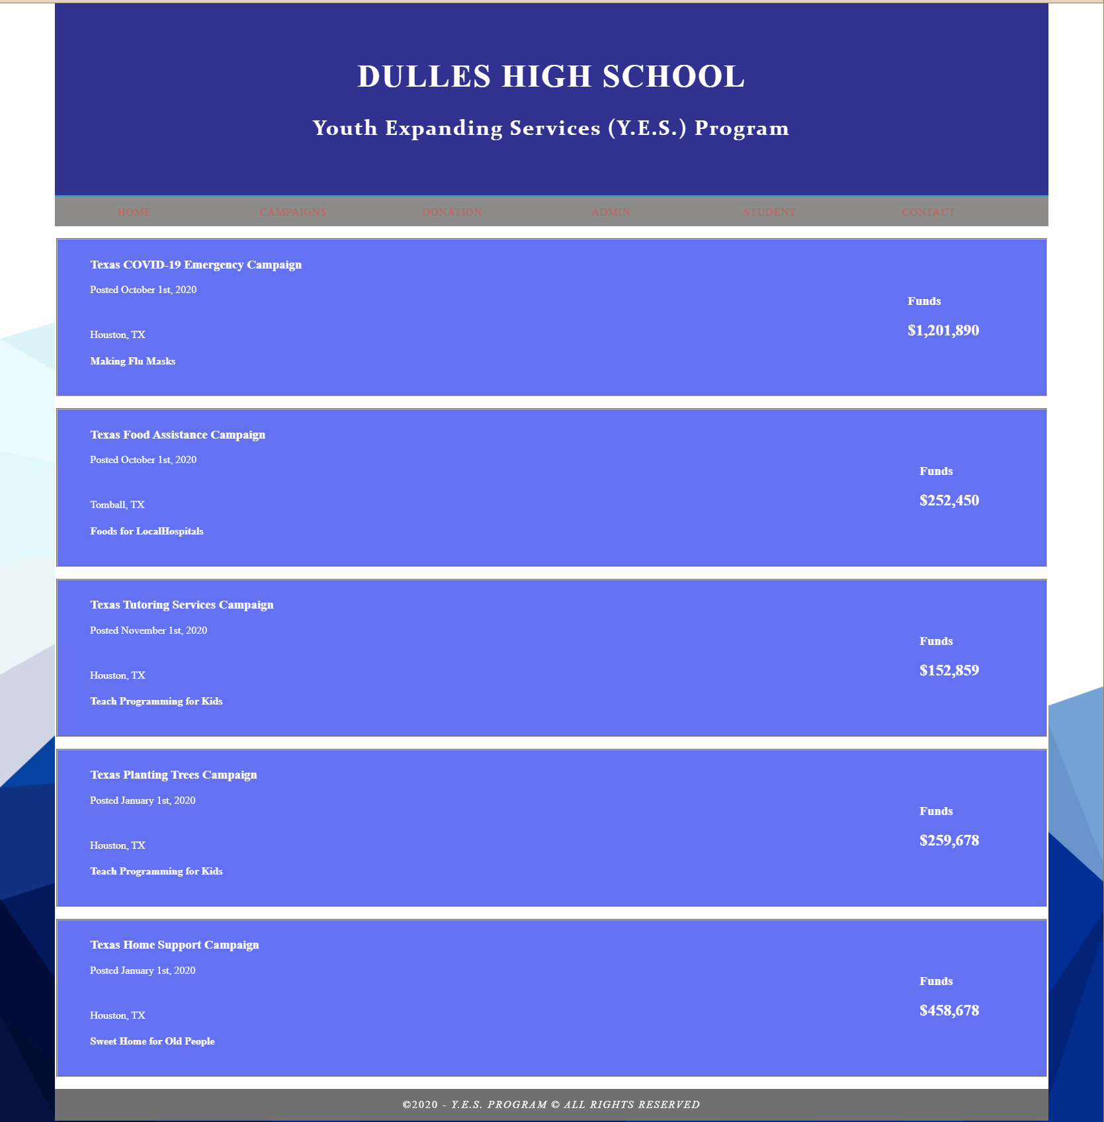
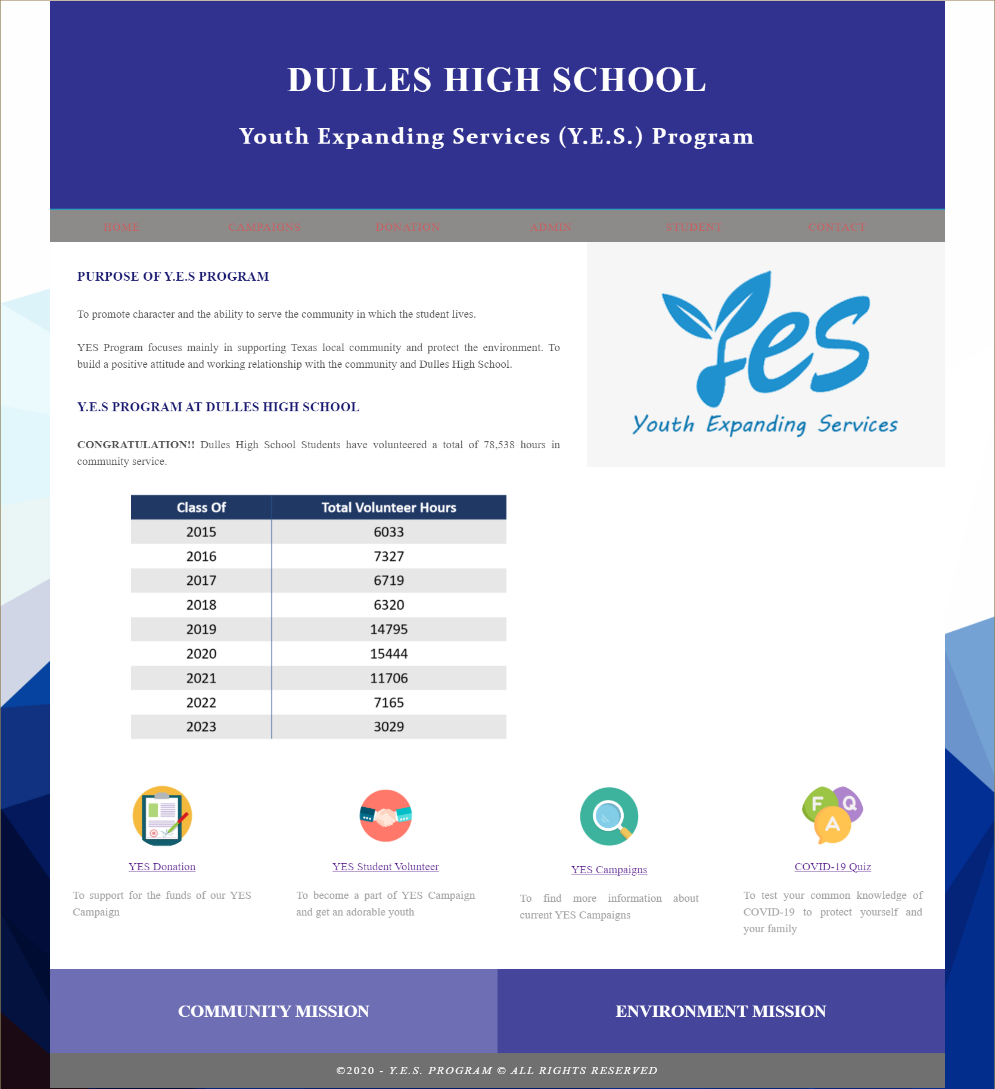
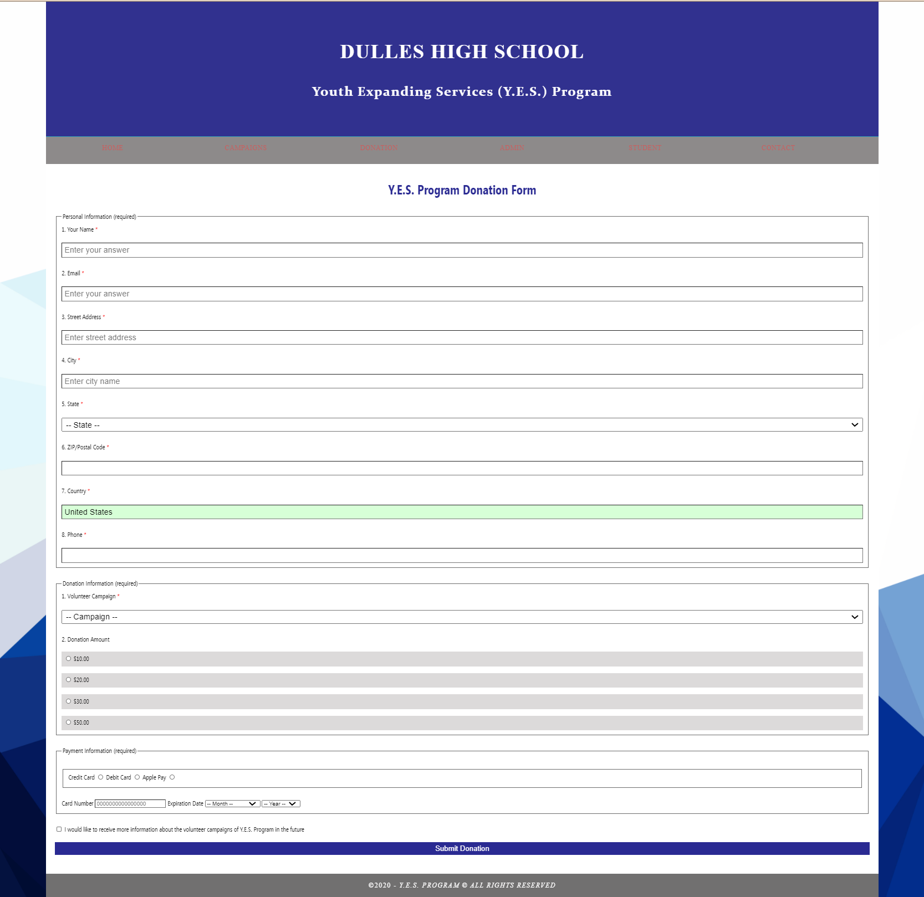
Main Pages
Campaigns
Homepage
Donation Form

Slide 9
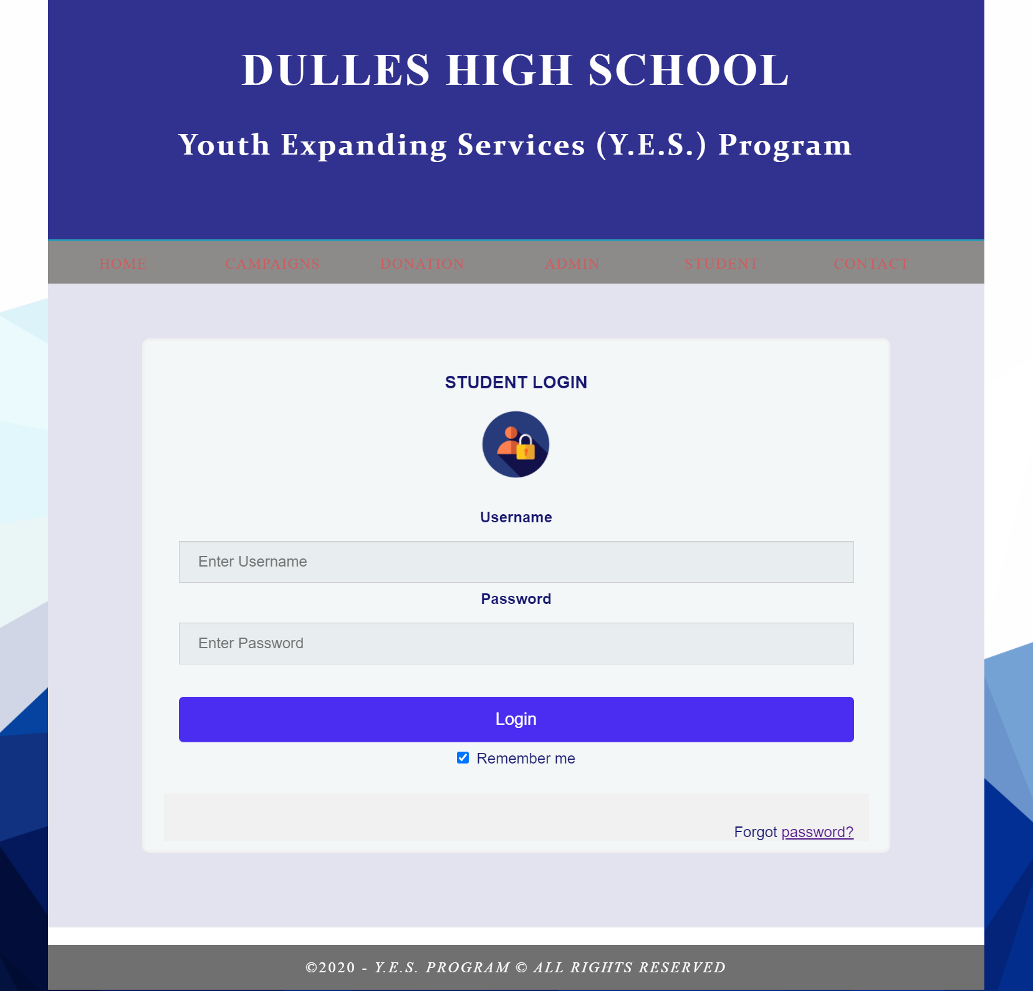
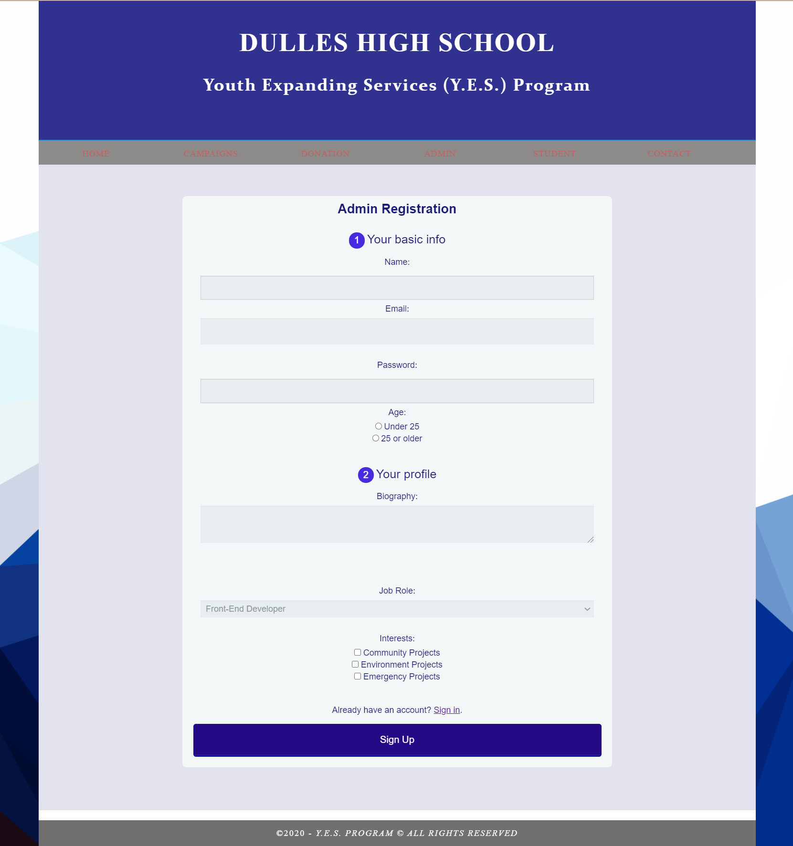
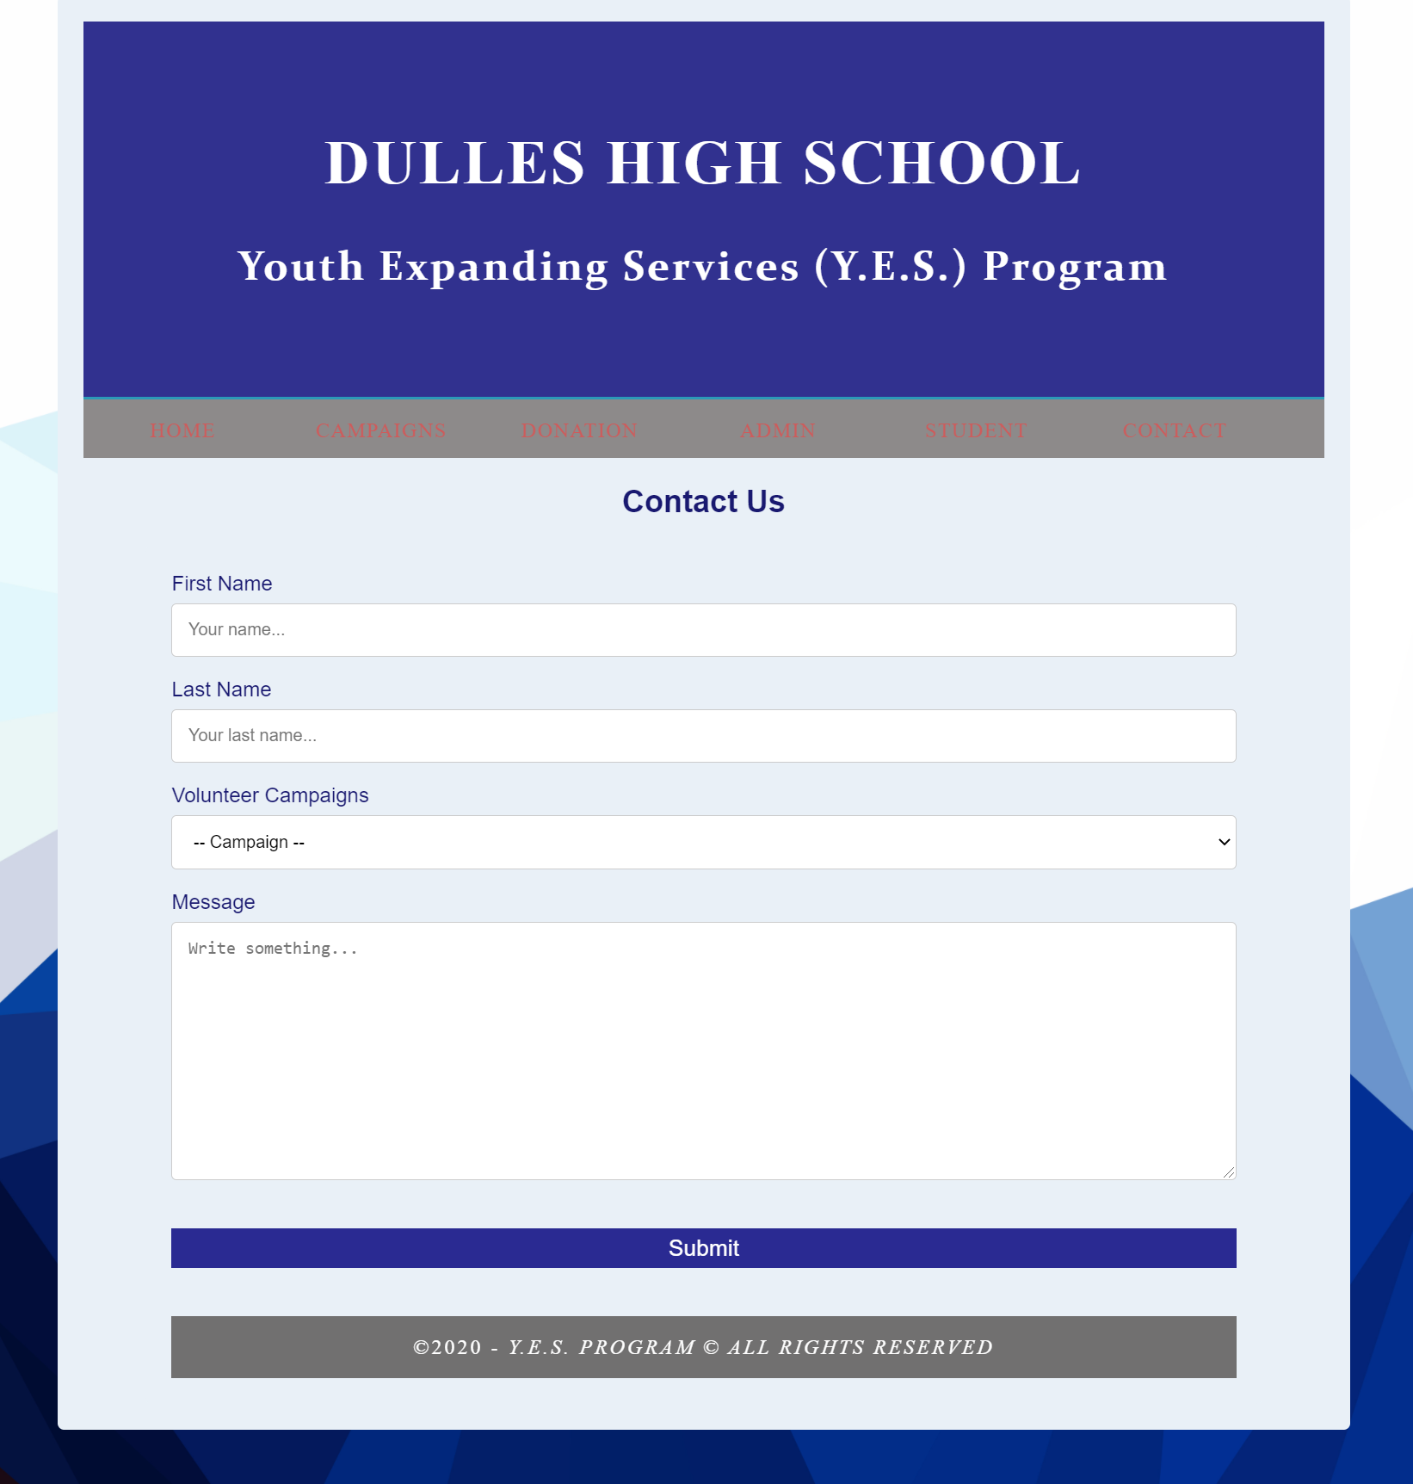
Main Pages
Login
Registration
Contact

Slide 10
COVID-19 Quiz
Javascript

Slide 11
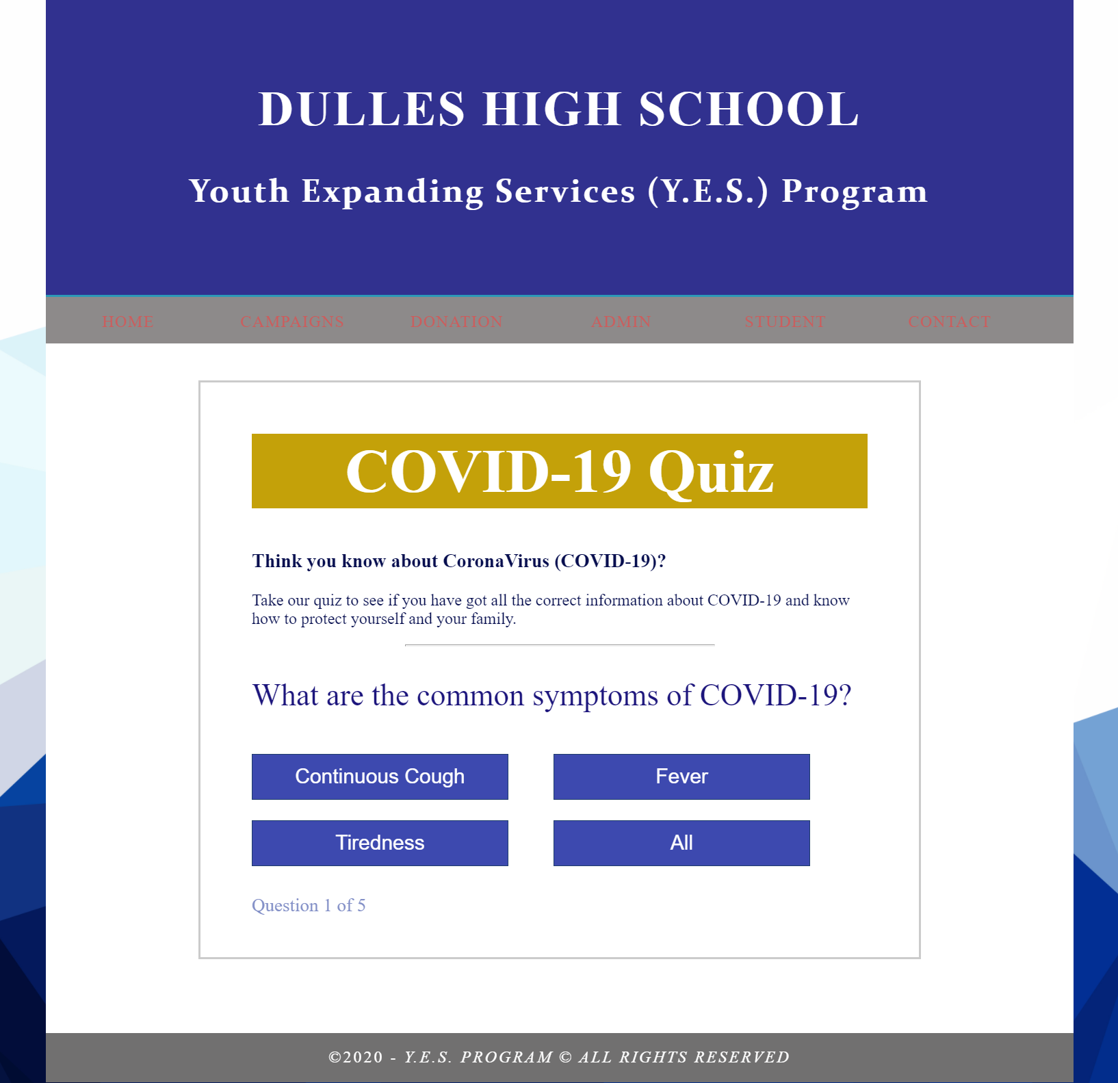
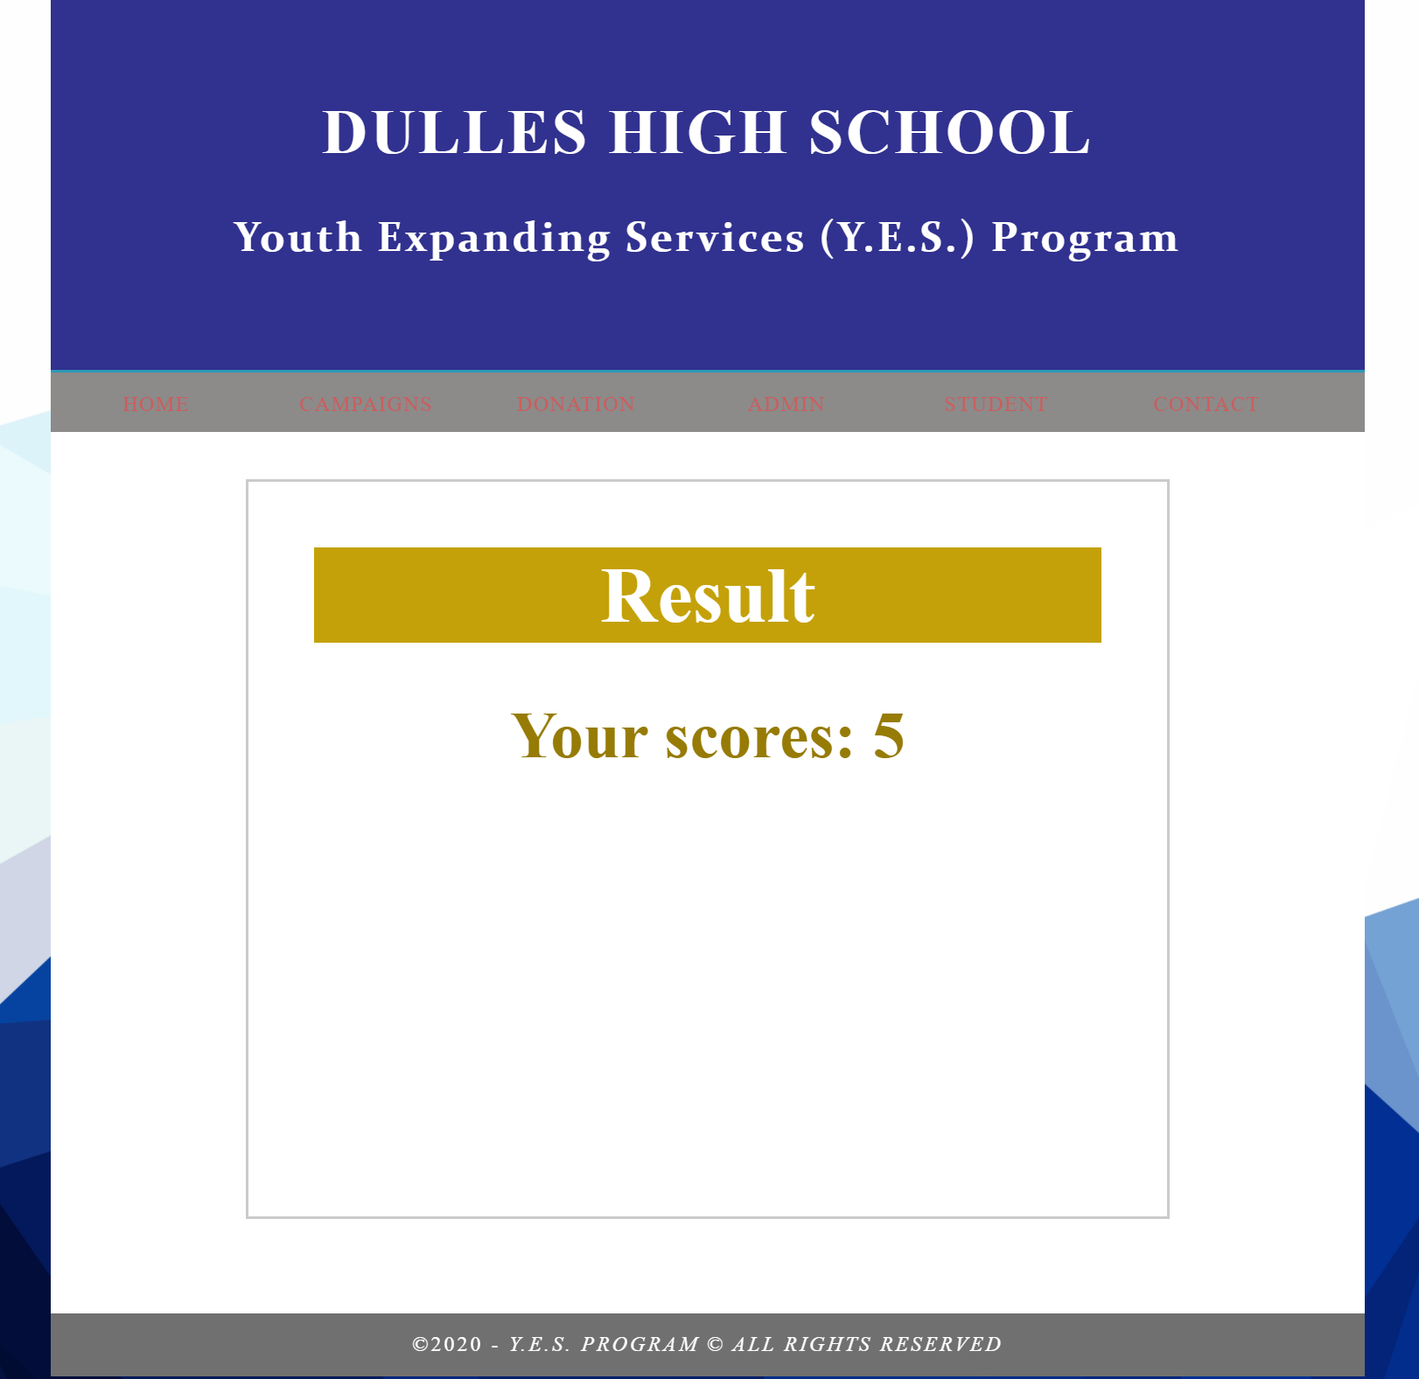
COVID-19 Quiz - Javascript
_ COVID-19 is a current top-priority mission of Y.E.S. Campaigns to support the community: hospitals, patients.
_ Also provide the accurate information for the community, especially high school students to protect themselves.

Slide 12
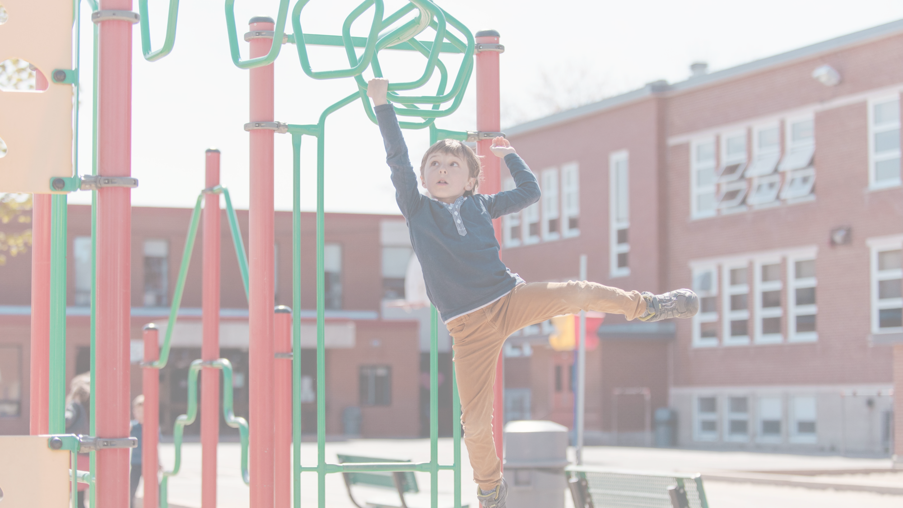
No one can do everything, but everyone can do something, and together we can change the world.
Ronald J. Sider
12/03/2020
Dulles High School

Slide 13
Responsive
Desktop – Tablet – Mobile device

Slide 14
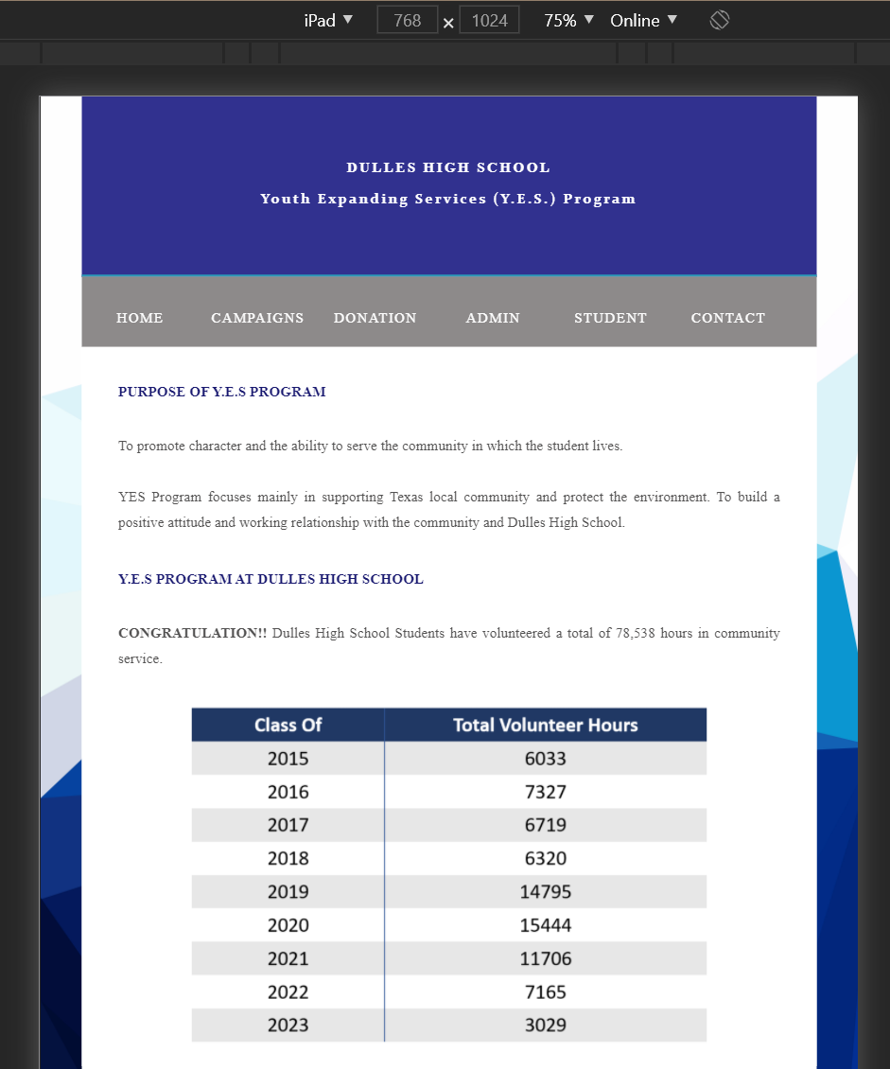
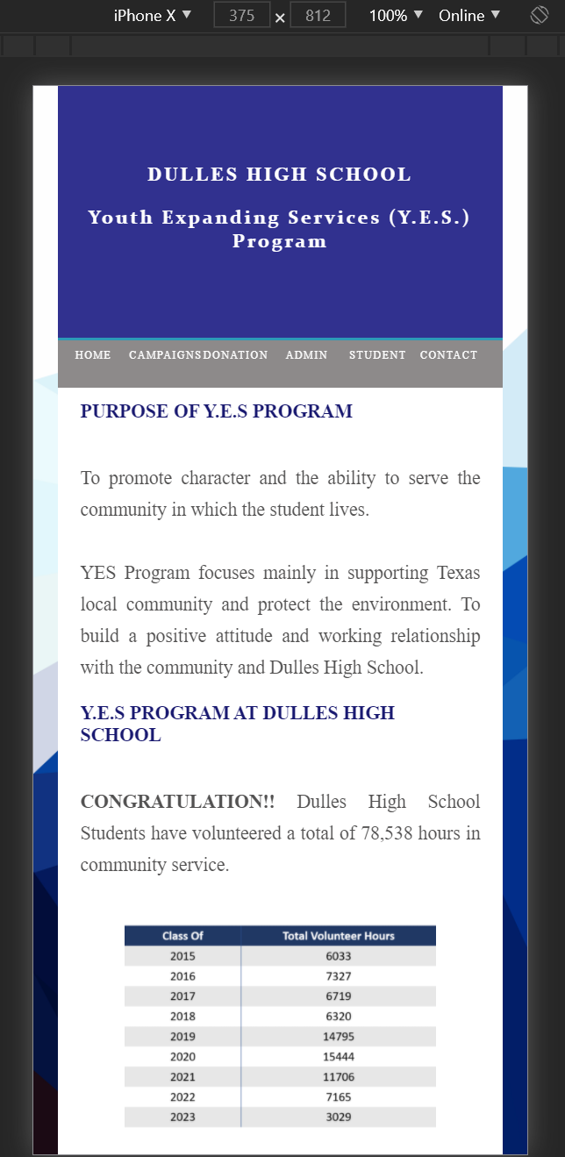
Desktop – Tablet – Mobile device
Desktop
iPad
iPhone

Slide 15


Summary
Y.E.S. Program wants to take responsibility in supporting the development of our community and environment.
We also wants to bring the volunteer opportunities for high school students who will become the owner of this country in the future.

Slide 16
Thank you
Presenter: Xuan Mai, Tran
Website: Dulles High School – Y.E.S. Program

